Slide 1
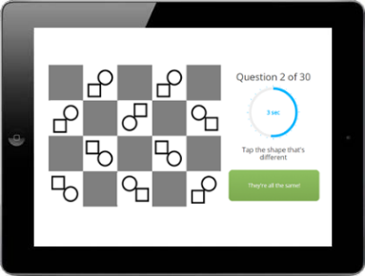
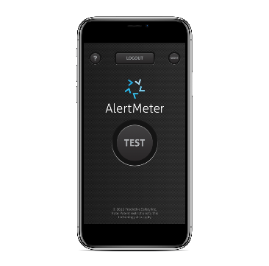
CASE STUDIES
Proprietary and Confidential
Notes:
Sample content slide with border, with text box, image w/ caption, no watermark

Slide 2
KEY METRIC
REDUCTION
DETAILS

Slide 3
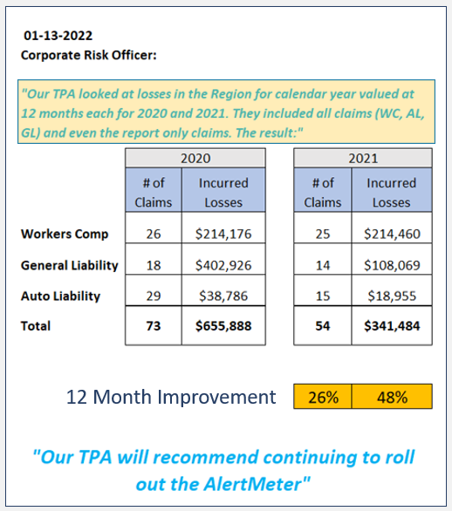
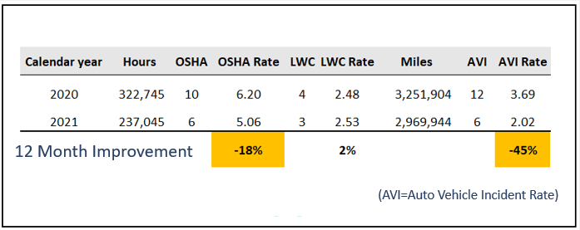
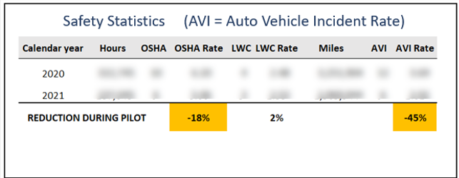
Before and After AlertMeter
Proprietary and Confidential

Slide 4
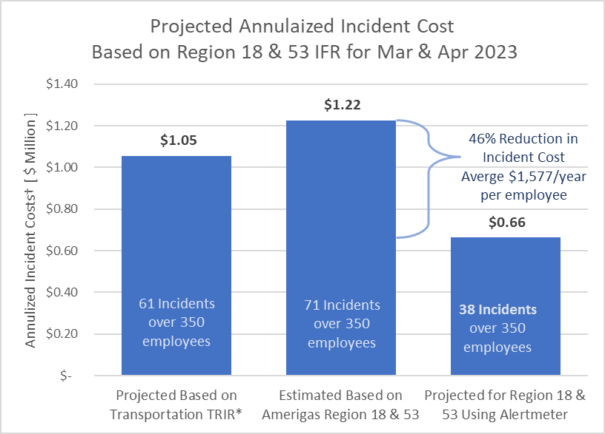
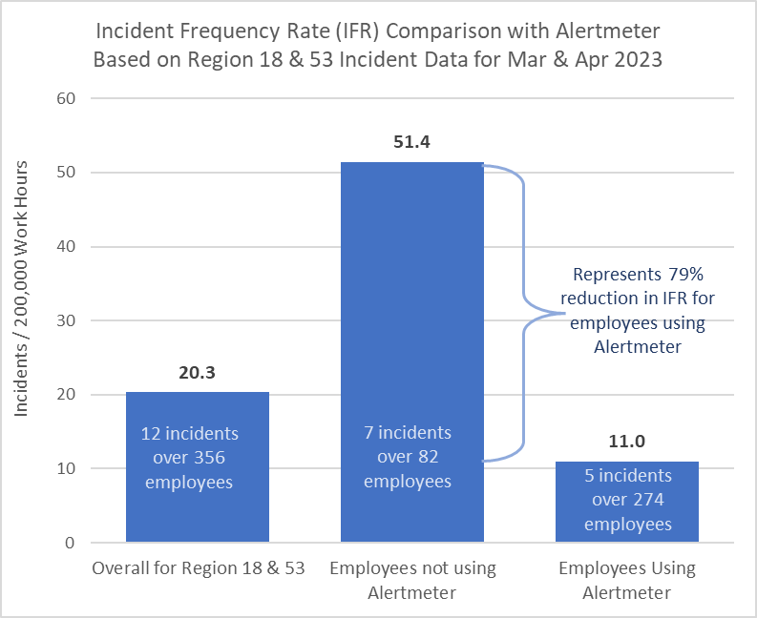
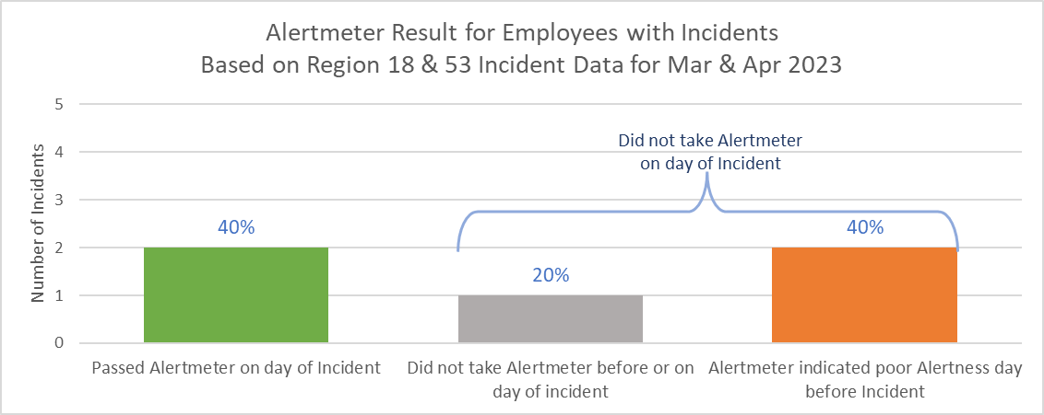
Benefits of alertmeter based on amerigas incident data
Over $560k of cost savings per year
Nearly 80% reduction in IFR when using Alertmeter
Opportunity to reduce incidents by another 30% to 40% by enforcing daily compliance
* TABLE 1. Incidence rates⁽¹⁾ of nonfatal occupational injuries and illnesses by industry and case types, 2021
† Based on estimated cost of $17,000 per incident across 350 employees

Slide 5
Trends and Observations
Fatigue, illness, and emotional distress top 3 most common issues discussed in weekly meetings.
Interruptions during testing occurred less than 10% of all tests on par with other companies using AlertMeter
Best in class average = 1.5% of all tests “outside normal range” AmeriGas is 2.0% which meets target
Low overhead for managers, more safety conversations
Followed HR provided protocols to address “outside normal range” notifications.

Slide 6
Feedback from crews
All AM’s and OM’s recommended to roll out the Alert Meter company wide.
The AM’s and OM’s felt confident that their employees would be able to perform their task safety that day, after completing the Alter Meter testing.
The AM’s and OM’s had a conversation with their employees about their wellbeing if they tested outside their normal range.
The employees started to notify the AM’s and OM’s immediately if they were outside of their normal range.
There were multiple employees that did not pass the first test but after waiting 10 to 15mins and collecting them self they passed the 2nd test.
One employee that did not pass the 2nd test, the AM had the employee work around the district rather than drive a bobtail that day.
One employee scored outside their normal range. After talking to the employee the AM decide the employee was not able to work that day and sent them home.

Slide 7
Stories from Documented ONR’s
Fatigued – Josh was out on a OOG call and got back late. We let him wait for a little while and then retest and changed his route to more local and fewer stops.
Fatigued - Will Nelson spoke with Larry, Larry stated he wasn't feeling good and didn't feel like he could drive so we decided to give him the day off.
Other User - spoke with Bruce, he had let an airborne driver try it. I explained don't do that in the live test. Finish his test and then put into demo mode if someone wants to try it
Stressed / Preoccupied - had Josh take a little time and focus on what he was doing as he was thinking about missing the test and some stuff he needed to get done.
Fatigued - Anthony, had a long day and was stuck in the mud, had to dig him self out. wanted to test system to see if it truly detected his Fatigue
Stressed / Preoccupied - Rick had some medical news that was not good and was just a little preoccupied
Fatigued - Talked with TJ, said he didn't sleep too well last night. Finally got to sleep late. Retested and passed, says he feels fine, Will check in with him again just to make sure he is still doing ok.
Proprietary and Confidential

Slide 8
Washington Metro Transit Authority
WMATA
Promoting Safety,
One Game At A Time
1100 DRIVERS

Slide 9
AlertMeter in MetroAccess
AlertMeter in MetroAccess
Every operator plays the game before they are allowed to enter revenue service
Operators can only enter service after a successful game playing attempt
Promote daily self-evaluations during the baseline development period
Develops leadership sensitivity to real-life fatigue management issues

Slide 10
FINDINGS
Reduces subjectivity
Promotes individual professional responsibility
Provides a platform for meaningful conversations
Improves the organizational safety posture
Union has been supportive, largely due to a soft roll out approach.

Slide 11
INITIAL KPI FINDINGS (Sept. – Dec. 2023)
REDUCED DOCUMENTED FATIGUE INCIDENTS BY 80%
Camera systems picking up people falling asleep
Curb strikes, etc.
IMPROVED SELF REPORTING FOR FATIGUE BY 65%

Slide 12
Predictive safety Journey to safer workplace
Recognize Risk:
ConGlobal recognizes that fatigue is a significant risk across its operations
Identify Risk:
By using the PRISM/AlertMeter® system, ConGlobal was able to identify 2785 fatigue risk conditions over the last 6 months
PRISM has been implemented at 5 locations over the last 6 months: Alliance, Atlanta, LPKC, Milpitas, & Phoenix
PRISM has been monitoring approximately 350 workers across the 5 locations
PRISM monitored fatigue risk across 35,000 shifts in real time
PRISM/AlertMeter® sends out a fatigue alert to the location management team 1 hour prior to the fatigue risk condition.
Based on the 10 incidents over the same period last year,
ConGlobal was able to reduce their TRIR by ~72% for this population in the last 6 months.
Reduced from 5.98 to 1.70 incidents per 200,000 worker hours
ConGlobal can potentially achieve an incident cost avoidance of ~$4M annually by implementing PRISM and/or AlertMeter® across all operations.
TRIR Reduction = 4.18 per 100 employees (2200 total field workers)
Cost Avoidance Calculation: 5.98-1.7 *42000 * 22 (# of field workers) = $3,954,720
Based on Dept of Labor Statistics of $42,000 average cost per Recordable Incident.

Slide 13
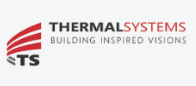
Situation: Thermal Systems
Thermal Systems has been a leading commercial and industrial building envelope subcontractor in Western Canada
since 1985. The company is involved with projects for the entire construction life cycle, from conception to completion,
offering multi-scope solutions and design assistance throughout the entire process.
“We see safety as a personal accountability issue,” said Christian Marchant, Director of Health, Safety, Environment,
and Quality. “People are our number-one asset, and we coach them in ways to help them manage their accountabilities
instead of policing and enforcing safety.”
While searching for a safety tool that fits Thermal Systems’ corporate culture in a way that prioritizes mental health,
Christian found an article featuring Predictive Safety. He glossed over it, not believing in the possibility of predicting
things like safety issues.
Proprietary and Confidential

Slide 14
Success Story: Thermal Systems
“We tested AlertMeter® for a couple of months by taking the test when we were actually fatigued, and it really did
reveal things about our mental states,” said Christian. “Now, a couple of years later, AlertMeter® is a part of our day-today
business.”
Everyone throughout the company uses AlertMeter® each day. Christian sees the results of the tests and works with
supervisors when workers on their team are functioning below their individual baseline.
“There is no pass or fail with AlertMeter®,” said Christian. “The one expectation we have is that people use it every day.
This gives the supervisor the opportunity to talk to the person to discover what issues might be impacting performance
so the supervisor can provide or arrange the proper support. It also works perfectly with our Ultimate Corporate Goal,
which is to revolutionize construction through people and technology.”

Slide 15
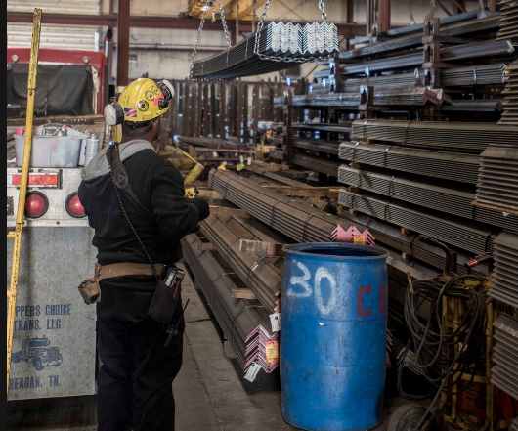
Success Story: Steel and Pipe Supply
Steel and Pipe Supply has been utilizing AlertMeter® for all their locations throughout the United States for the last year and a half.
In 2023, their Tulsa Flat Roll location was understaffed yet had high production goals.
Temperatures were extreme and fatigue was inevitable.
They could not send people home without impacting production.
Proprietary and Confidential

Slide 16
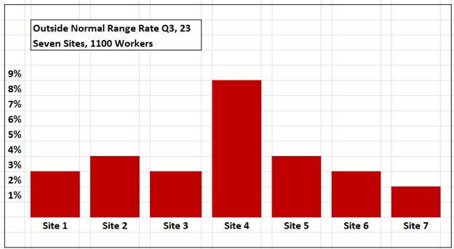
Success Story: Steel and Pipe Supply
At Tulsa Flat roll – Site 4
Average Notified ONR Rate is 2.5% for other six sites.
ONR Rate of 8.5% for the quarter
Hit production records
Incident Rate = ZERO
INCIDENT RATE WAS ZERO BECAUSE THE PEOPLE NEEDING COACHING WERE BEING IDENTIFIED AND MANAGED
Proprietary and Confidential

Slide 17
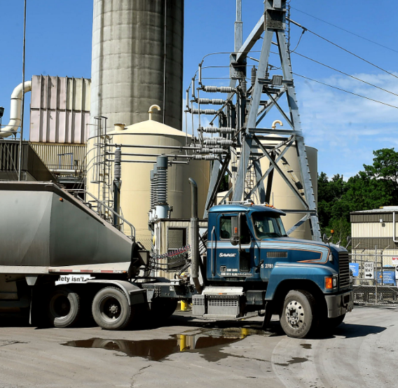
Success Story Transportation
“We think the AlertMeter® is the best bang for the buck of any of our safety practices. The feedback it gives to our employees motivates them to take responsibility for their off-time lifestyle behavior. They are definitely arriving more alert and more rested than they used to.”
Dickson Morley, SH&E Director Savage Services
Fleets, rail and marine operations. 400 facilities in the US.

Slide 18
93% reduction in the first year after Alertmeter across 7 sites
Reduced losses by 93% in the first 12 months on AlertMeter
**Work Hours: All incident data normalized to 200,000 work hours per OSHA Incident Frequency Rate, (100 workers X 2000 hours/year)
Proprietary and Confidential

Slide 19
Comparing losses between AlertMeter sites and Non-AlertMeter sites
within the same organization
The sites using AlertMeter provide same services and function to the enterprise as those not using AlertMeter
Reduction of Losses over time likely due to other safety initiatives implemented
Safety initiatives were initiated at ALL sites over the past three years.
The AlertMeter sites performed better than non AlertMeter sites
Alertmeter sites have stabilized around $ 280K Losses per 100 drivers
Sites Without AlertMeter
Sites With AlertMeter
Proprietary and Confidential

Slide 20
Transportation Case Study
Reduction of Transportation Loss Severity with Alertmeter
Sites Using Alertmeter have fewer incidents where losses exceed $ 25K
Incidents with more than $ 100K cost are 2 times more likely on sites not using Alertmeter
Percent of incidents that exceed $25K run 7.2% on sites using Alertmeter compared to 9.9% on sites that are not using Alertmeter.
Incidents that cause more that $100K in losses are twice more frequent on sites not using Alertmeter
Proprietary and Confidential

Slide 21
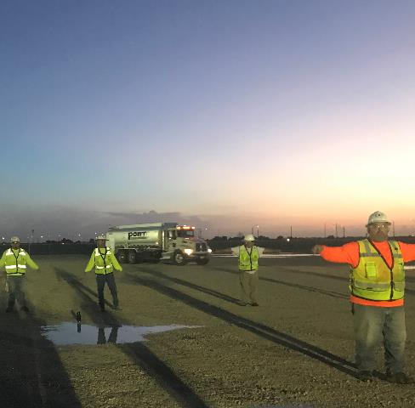
Success Story: Global Construction Company
Three Month Study
Three identical projects in South Florida
One project uses AlertMeter®
Results:
37% fewer incidents at the AlertMeter® Project
Quality was better at AlertMeter® project
34% lower on random drug test failure, 50% lower on pre-employment failure

Slide 22
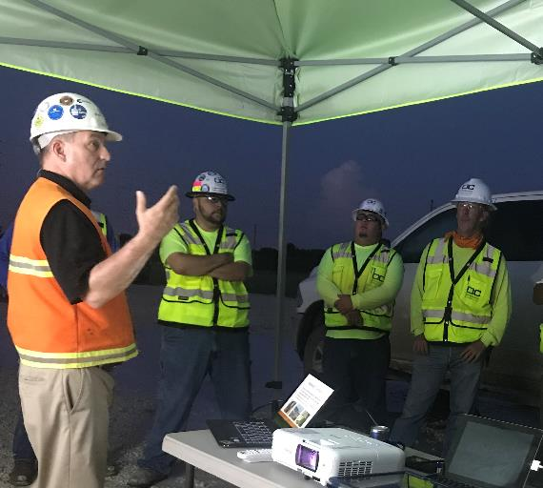
Success Story: Global Construction Company
Survey Results:
“AlertMeter® improved my safety, I am safer, I feel safer.”
50% agree or strongly agree
40% Neutral/10% Disagreed
20% of respondents stated improved sleep and reduced alcohol use.
Energy and Telecommunications

Slide 23
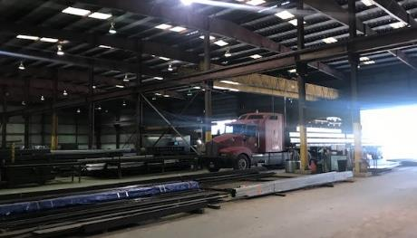
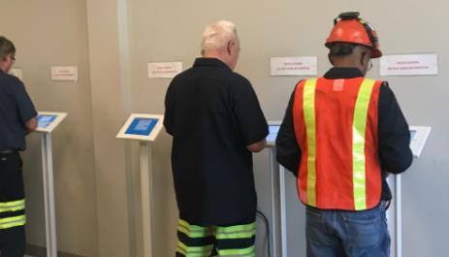
Distribution Warehouse Transportation
30% reduction in Workers Compensation Insurance claims
50% reduction in Total Recordable Incident Rate (1.6 down to 0.8)
52% reduction in total average cost of incidents
40 warehouse / distribution centers supplying construction supplying any industry that needs steel. (Oil, Construction, Mining etc.)

Slide 24
Interview with the VP Safety of Triple-S Steel:
How many facilities and employees at Triple-S are using the AlertMeter®?
We have 1500 people at 65 locations in the U.S. using the AlertMeter®.
Q. What has changed at Triple-S since you implemented the AlertMeter®?
At the facilities where AlertMeter® has been used, our incident rate is now very close to zero.
Q. What other improvements have you seen?
The interaction between our leadership team and our employees from a safety perspective has just gone through the roof. It has increased everyone’s safety awareness.
Second, in states where marijuana has been legalized, the morale has really improved because there’s more assurance that everyone is fit for work.
Proprietary and Confidential

Slide 25
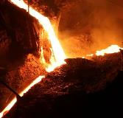
Success Story Manufacturing
Vforge produces aluminum parts for the motorcycle, airline, and healthcare industries.
A two-year study showed significant improvement and reduced costs in numerous areas of the company.
70% reduction in workers comp claims
90% reduction in drug testing costs
35% reduction in employee turnover
11% increase in productivity
Issues they needed to address:
Employee Moral
Ineffective drug testing results
Difficulty hiring good people that could pass a drug test
Losing good employees that failed random THC testing
Confirmed by Pinnacol Assurance

Slide 26
Comparing Anglo Platinum with Industry Safety Indices and Trends
Year 1 Year 2 Year 3 Year 4 Year 5 Year 6 Year 7 Year 8
Year 1 Year 2 Year 3 Year 4 Year 5 Year 6 Year 7 Year 8
Implementation of AlertMeter® and PRISM at Platinum Mine 2000 workers:
Source: Katlego Letsoalo

Slide 27
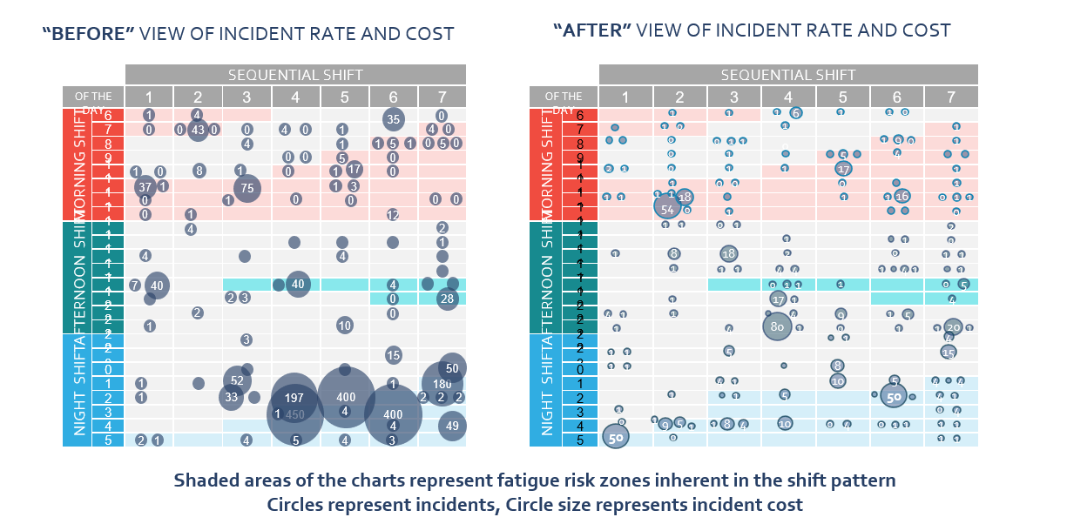
Study of Financial Impact of Equipment Damage Before and After AlertMeter
Anglo Mogalakwena Platinum – South Africa
Source: Katlego Letsoalo

